Slide 1
Operating Systems (A) (Honor Track) Lecture 12: Scheduling (I)
Yao Guo (郭耀)
Peking University
Fall 2024
Acknowledgements: Prof. Xiangqun Chen & Tao Wang at PKU and Prof. Yuanyuan Zhou at UCSD

Slide 2
This Lecture
Scheduling Overview
Single Processor Scheduling
Scheduling for batch systems
Interactive scheduling

Slide 3
Buzz Words
Scheduling
Long-term scheduler, or job scheduler
Short-term scheduler, or CPU scheduler
Dispatcher
Preemptive scheduling
Non-preemptive scheduling

Slide 4
Multiprogramming
In a multiprogramming system, we try to increase CPU utilization and job throughput by overlapping I/O and CPU activities
Requires a combination of mechanisms and policy
We have covered the mechanisms
Context switching, how and when it happens
Process queues and process states
Now we’ll look at the policies
Which process (thread) to run, for how long, etc.
Making this decision is called scheduling
We’ll refer to schedulable entities as jobs (standard usage) – could be processes, threads, people, etc.

Slide 5
Long-term vs. Short-term Schedulers
Long-term scheduler, or job scheduler
In a batch system, some processes are spooled to a mass-storage device for later execution
Selects processes from this pool and loads them into memory (for execution)
Short-term scheduler, or CPU scheduler
Selects those from among the processes that are ready to execute and allocates the CPU to one of them
Notes:
Often, in a batch system, more processes are submitted than can be executed immediately. These processes are spooled to a mass-storage device (typically a disk), where they are kept for later execution. The long-term scheduler, or job scheduler, selects processes from this pool and loads them into memory for execution. The short-term scheduler, or CPU scheduler, selects from among the processes that are ready to execute and allocates the CPU to one of them.

Slide 6
Related Concepts of CPU Scheduler
Dispatcher
Preemptive vs. non-preemptive
CPU
Dispatcher
Proc 1
Proc 10
Proc 2
Proc 11
Proc 3
Proc 12
Ready queue
blocked queue
Notes:
Dispatcher: the module that gives control of the CPU to the process selected by the short-term scheduler

Slide 7
Dispatcher
Gives the control of the CPU to the process, scheduled by the short-term scheduler
Dispatcher Functions
Switching context
Switching to user mode
Jumping to the proper location in the user program
Dispatch Latency: time to stop process and start another one
Pure overhead
Needs to be fast

Slide 8
Preemptive vs. Non-preemptive
Non-preemptive scheduling
The running process keeps the CPU until it voluntarily gives up the CPU
process exits
switches to blocked state
1 and 4 only (no 3)
Preemptive scheduling
The running process can be interrupted and must release the CPU (can be forced to give up CPU)
Running
4
Terminated
3
1
Ready
Blocked

Slide 9
When to Schedule?
A new process starts
The running process exits
The running process is blocked
I/O interrupt (some processes will be ready)
Clock interrupt (e.g. every 10 milliseconds)

Slide 10
Scheduling Objectives
Performance
Fair
Priority
Encourage good behavior
Support heavy loads
Adapt to different environments
interactive, real-time, multi-media

Slide 11
Performance Criteria
Efficiency: keep resources as busy as possible
Throughput: # of processes that completes in unit time
Turnaround Time
The interval from the time of submission of a process to the time of completion
Waiting Time
The sum of the periods spent waiting in the ready queue.
Response Time
The amount of time from when a request was first submitted until first response is produced.
Predictability and variance (Why is this important? )
Meeting Deadlines: avoid losing data
Notes:
Investigators have suggested that, for interactive systems (such as time- sharing systems), it is more important to minimize the variance in the response time than to minimize the average response time. A system with reasonable and predictable response time may be considered more desirable than a system that is faster on the average but is highly variable. However, little work has been done on CPU-scheduling algorithms that minimize variance.

Slide 12
Different Systems, Different Focuses
For all
Fairness, policy enforcement, resource balance
Batch Systems
Max throughput, min turnaround time, max CPU utilization
Interactive Systems
Min Response time, …
Real-Time Systems
Predictability, meeting deadlines

Slide 13
Program Behaviors Considered in Scheduling
Is it I/O bound? Example?
Is it CPU bound? Example?
Batch or interactive environment
Urgency
Priority
Frequency of page faults
Frequency of preemption
How much execution time it has already received
How much execution time it needs to complete
I/O
I/O
I/O
compute
compute

Slide 14
This Lecture
Scheduling Overview
Single Processor Scheduling
Scheduling for batch systems
Interactive scheduling

Slide 15
Buzz Words
First come first serve (FCFS)
Shortest job first (SJF)
Starvation
Round-robin (RR)
Priority inversion
Priority inheritance
Multiple-level feedback queues (MLFQ)

Slide 16
This Lecture
Scheduling Overview
Single Processor Scheduling
Scheduling for batch systems
Interactive scheduling

Slide 17
First Come First Serve (FCFS)
Process that requests the CPU FIRST is allocated the CPU FIRST
Also called FIFO
Non-preemptive
Real life analogy: Fast food restaurant
Implementation: FIFO queues
A new process enters the tail of the queue
The scheduler selects from the head of the queue
Performance metric: Average Waiting Time (AWT)
Given Parameters:
Duration(in ms), Arrival Time and Order

Slide 18
FCFS Example
Process | Duration | Order | Arrival Time
P1 | 24 | 1 | 0
P2 | 3 | 2 | 0
P3 | 4 | 3 | 0
The final schedule:
P1 (24)
P2 (3)
P3 (4)
0
24
27
P1 waiting time: 0
P2 waiting time: 24
P3 waiting time: 27
The average waiting time: (0+24+27)/3 = 17

Slide 19

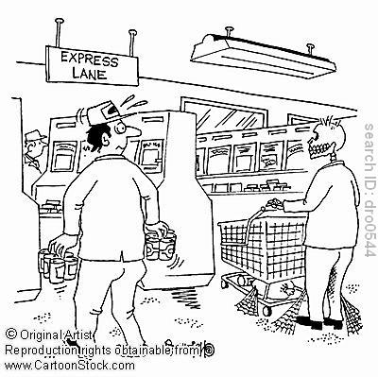
Problems with FCFS
Non-preemptive
Not optimal AWT (average waiting time)
Average waiting time can be large if small jobs wait behind long ones
E.g., You have a basket, but you’re stuck behind someone with a full shopping cart?
Solution?
Express lane (5 items or less)

Slide 20
Shortest Job First (SJF)
Schedule the job with the shortest duration first
Two types: Non-preemptive & Preemptive
Requirement: the lengths of the jobs need to be known in advance
Optimal if all the jobs are available simultaneously (provable). Why?
Gives the best possible AWT (average waiting time)
Real life analogy?
Express lane in supermarket
Shortest important task first --The 7 Habits of Highly Effective People
Notes:
The SJF scheduling algorithm is provably optimal, in that it gives the minimum average waiting time for a given set of processes. Moving a short process before a long one decreases the waiting time of the short process more than it increases the waiting time of the long process. Consequently, the average waiting time decreases.

Slide 21
Non-preemptive SJF: Example
Process | Duration | Order | Arrival Time
P1 | 6 | 1 | 0
P2 | 8 | 2 | 0
P3 | 7 | 3 | 0
P4 | 3 | 4 | 0
P4 (3)
P1 (6)
P3 (7)
P2 (8)
0
3
9
16
24
P4 waiting time: 0
P1 waiting time: 3
P3 waiting time: 9
P2 waiting time: 16
The total time is: 24
The average waiting time (AWT): (0+3+9+16)/4 = 7

Slide 22
Comparing to FCFS
Process | Duration | Order | Arrival Time
P1 | 6 | 1 | 0
P2 | 8 | 2 | 0
P3 | 7 | 3 | 0
P4 | 3 | 4 | 0
P1 (6)
P2 (8)
P3 (7)
P4 (3)
0
6
14
21
24
P1 waiting time: 0
P2 waiting time: 6
P3 waiting time: 14
P4 waiting time: 21
The total time is the same (why?)
The average waiting time (AWT): (0+6+14+21)/4 = 10.25
(7 in SJF)

Slide 23
SJF is Not Always Optimal
Process | Duration | Order | Arrival Time
P1 | 10 | 1 | 0
P2 | 2 | 2 | 2
Is SJF optimal if all the jobs are not available simultaneously?
P1 (10)
P2 (2)
0
2 (p2 arrives)
10
12
P1 waiting time: 0
P2 waiting time: 8
The average waiting time (AWT): (0+8)/2 = 4

Slide 24
What if the Scheduler Waits for 2 Time Units?
Process | Duration | Order | Arrival Time
P1 | 10 | 1 | 0
P2 | 2 | 2 | 2
P2 (2)
P1 (10)
0
2
4
14
The average waiting time (AWT): (0+4)/2 = 2
However: waste 2 time units of CPU
P1 waiting time: 4
P2 waiting time: 0

Slide 25
Preemptive SJF
Also called Shortest Remaining Time First
Schedule the job with the shortest remaining time required to complete
Requirement: the lengths of the jobs need to be known in advance

Slide 26
Preemptive SJF: Same Example
Process | Duration | Order | Arrival Time
P1 | 10 | 1 | 0
P2 | 2 | 2 | 2
P1 (2)
P2 (2)
P1 (8)
0
2
4
12
The average waiting time (AWT): (0+2)/2 = 1
No CPU waste!!!
P1 waiting time: 4-2 =2
P2 waiting time: 0

Slide 27

A Problem with (Preemptive) SJF
Starvation
In some condition, a job is waiting forever
Example: SJF
Process A with length of 1 hour arrives at time 0
But every 1 minute, a short process with length of 2 minutes arrives
Result of SJF: A never gets to run

Slide 28
This Lecture
Scheduling Overview
Single Processor Scheduling
Scheduling for batch systems
Interactive scheduling

Slide 29
Interactive Scheduling Algorithms
Usually preemptive
Time is sliced into quantum (time intervals)
Scheduling decision is also made at the beginning of each quantum
Performance criteria
Min response time
AWT is also important
Representative algorithms:
Round-robin
Priority-based
Extra: what happened on Mars ?
…

Slide 30
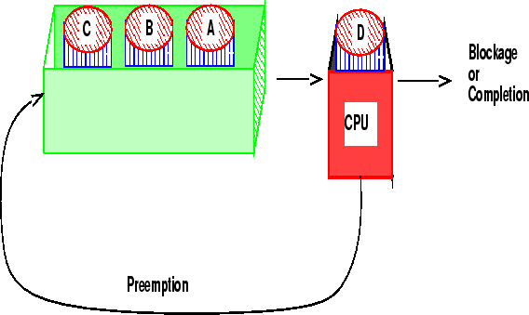
Round-robin
One of the oldest, simplest, most commonly used scheduling algorithm
Select process/thread from ready queue in a round-robin fashion (take turns)
Difference with FIFO?
Problem:
Do not consider priority
Context switch overhead

Slide 31
Round-robin: Example
Process | Duration | Order | Arrival Time
P1 | 3 | 1 | 0
P2 | 4 | 2 | 0
P3 | 3 | 3 | 0
Suppose time quantum is: 1 unit, P1, P2 & P3 never block
P1
P2
P3
P1
P2
P3
P1
P2
P3
P2
0
10
P1 waiting time: 4
P2 waiting time: 6
P3 waiting time: 6
The average waiting time (AWT): (4+6+6)/3 = 5.33

Slide 32
Time Quantum
Time slice too large
FIFO behavior
Poor response time
Time slice too small
Too many context switches (overheads)
Inefficient CPU utilization
Heuristic: 70-80% of jobs block within time-slice
Typical time-slice 10 to 100 ms
Time spent in system depends on the size of the job
Notes:
Thus, we want the time quantum to be large with respect to the context- switch time. If the context-switch time is approximately 10 percent of the time quantum, then about 10 percent of the CPU time will be spent in context switching. In practice, most modern systems have time quanta ranging from 10 to 100 milliseconds. The time required for a context switch is typically less than 10 microseconds; thus, the context-switch time is a small fraction of the time quantum.

Slide 33
Simple Calculation (1 minute)
Suppose a context switch takes 1 msec
Suppose the scheduling quantum is 100 msec
What is the percentage overhead of context switches in round-robin scheduling?
What if the scheduling quantum is 10 msec?
Notes:
1: 1%
2: 10% = 9.1%

Slide 34
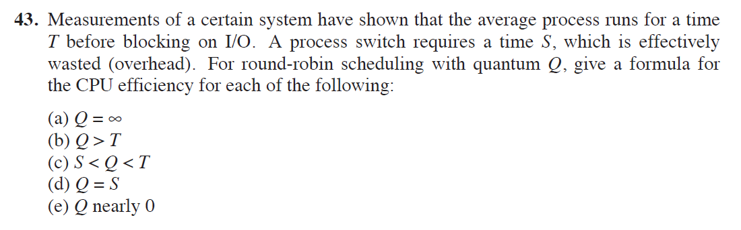
Exercise (Ch 2-43)
Notes:
（a）T/(T+S) (b) T/(T+S)
(c) T/(T+ [T/Q]*S) 约等于 Q/(Q+S)
(d) 1/2
(e) 0

Slide 35
Priority Scheduling
Each job is assigned a priority
FCFS/RR within each priority level
Select highest priority job over lower ones
Motivation: higher priority jobs are more mission-critical
Example: video player vs. send email
Note: the priority of a process may be changed over time
Real life analogy?
Boarding at airports
Problems:
May not give the best AWT
Indefinitely blocking or “starving” a process

Slide 36
How to Set Priority?
Two approaches
Static (for system with well known and regular application behaviors)
Dynamic (otherwise)
Priority may be based on:
Cost to user
Importance of user
Aging
Percentage of CPU time used in last X hours

Slide 37
Priority Scheduling: Example
Process | Duration | Priority | Arrival Time
P1 | 6 | 4 | 0
P2 | 8 | 1 | 0
P3 | 7 | 3 | 0
P4 | 3 | 2 | 0
P2 (8)
P4 (3)
P3 (7)
P1 (6)
0
8
11
18
24
P2 waiting time: 0
P4 waiting time: 8
P3 waiting time: 11
P1 waiting time: 18
The average waiting time (AWT): (0+8+11+18)/4 = 9.25
(worse than SJF)

Slide 38
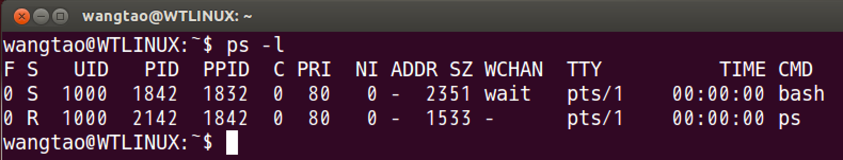
Priority in Unix
Notes:
PRI: Higher number means lower priority.

Slide 39
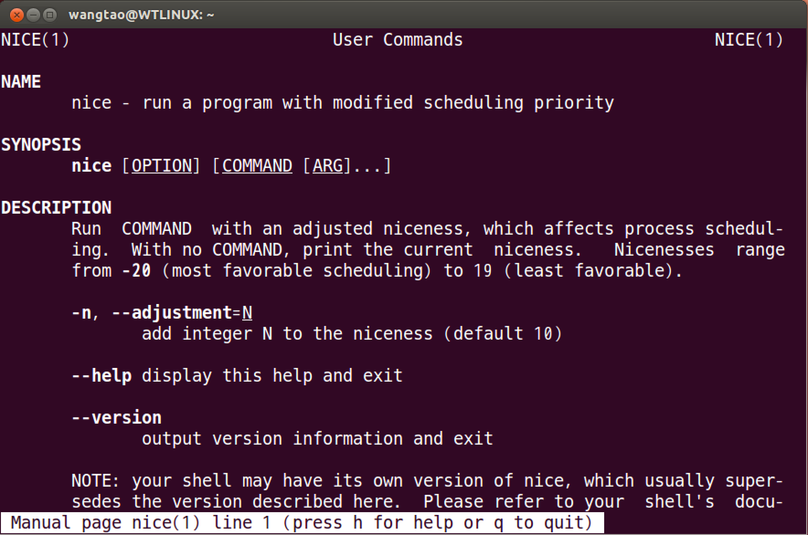
Be “nice” in Unix
Notes:
A normal user can only set niceness to a positive number

Slide 40
More on Priority Scheduling
Priority inversion is a risk unless all resources are jointly scheduled
x->Acquire()
H
priority
x->Acquire()
x->Release()
L
time
x->Acquire()
H
How can this be avoided?
M
priority
x->Acquire()
time
L
Notes:
In spite of the good design of these two cooperating tasks H and L, the surprising behavior, priority inversion, occurs when any third task M of medium priority becomes runnable during L's use of R. Once H becomes unrunnable, M is the highest priority runnable task, thus it runs and while it does L cannot relinquish R. So in this scenario, the medium priority task preempts the high priority task, resulting in a priority inversion.

Slide 41
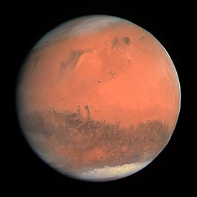
Scheduling on Mars
What happened on Mars?
* Photos from NASA

Slide 42
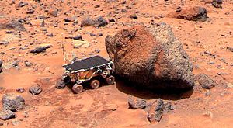

What Happened on Mars?
Mars Pathfinder probe (1997)
Nice launch (1996.12.4)
Nice transit
Nice de-orbit
Nice thump-down with inflatable air-bag (1997.7.4)
Nice rover disembarkation
Nice spontaneous reboots! (on July 5, 10, 11 and 14)
* Photos from NASA

Slide 43
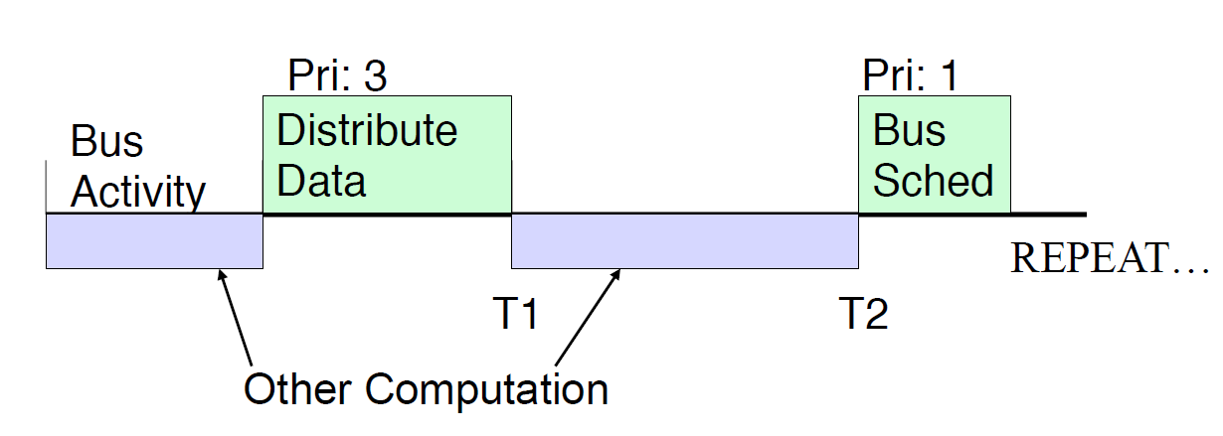
Software Design
T1 < T2 or else system reboots!!!
Notes:
（横线上面是Bus activity；横线下面是other computation）
Bus activity: distribute data, bus scheduled;
so it is like: transfer data, compute, transfer data, compute, …
Priority: 1 is the highest, 3 is pretty high

Slide 44
Software Design
Other computation (threads)
W (weather data thread): low priority
Many medium priority tasks
Distribute Data sends data to W via a software pipe facility

Slide 45
What Could Go Wrong?
Weather thread (W) locks pipe to read data
High-priority Distribute Data must wait to write data
Interrupt makes other tasks runnable
Higher priority, so preempt W
W does not release lock for a long time…

Slide 46
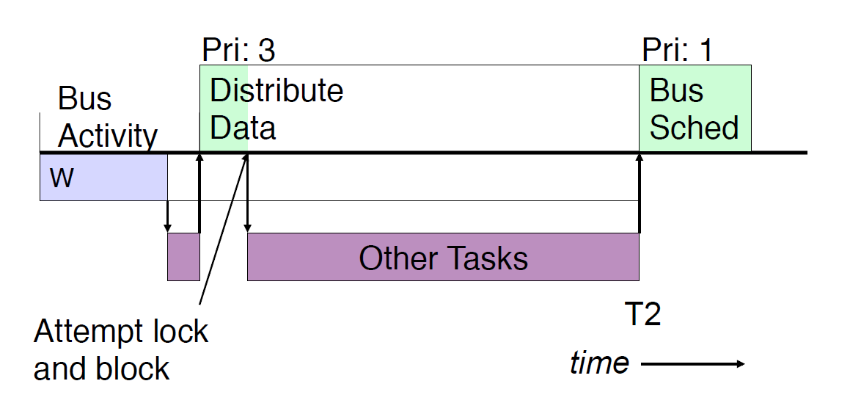
Priority Inversion
T1 >= T2 : Oh no! system reboots!!!
Notes:
W was preempted and did not release the lock (with Distribute Data). Then Distribute Data could not continue…

Slide 47
Solution: Priority Inheritance
Priority inversion
x->Acquire()
H
priority
x->Acquire()
x->Release()
L
time
x->Acquire()
H
How can this be avoided?
M
priority
x->Acquire()
time
L
Priority inheritance
Lower-priority job inherits the priority of any higher priority job pending on a resource they share
Notes:
Priority inheritance
Under the policy of priority inheritance, whenever a high priority task has to wait for some resource shared with an executing low priority task, the low priority task is temporarily assigned the priority of the highest waiting priority task for the duration of its own use of the shared resource, thus keeping medium priority tasks from pre-empting the (originally) low priority task, and thereby affecting the waiting high priority task as well. Once the resource is released, the low priority task continues at its original priority level.

Slide 48
History of the Idea
Priority Inheritance Protocols: An Approach to Real-Time Synchronization
IEEE Transactions on Computers 39:9 (1990.9)
1987.12 “Manuscript” received
Authors: Lui Sha (CMU SEI), Ragunathan Rajkumar (IBM Research ⇒ CMU ECE), John Lehoczky (CMU Statistics)
Implemented in WindRiver VxWorks RTOS
Rescues Mars Pathfinder (1997)
History courtesy of Mike Jones and Glen Reeves (Debate)
http://www.cs.cmu.edu/~rajkumar/mars.html
http://www.cs.duke.edu/~carla/mars.html
Notes:
The feature of priority inheritance was implemented in Mars Pathfinder but had not been turned on for performance reasons…

Slide 49
Combining Algorithms
Scheduling algorithms can be combined
Have multiple queues
Use a different algorithm for each queue
Move processes among queues
Example: multiple-level feedback queues (MLFQ)
Multiple queues representing different job types
Interactive, CPU-bound, batch, system, etc.
Queues have priorities, jobs on same queue scheduled RR
Jobs can move among queues based upon execution history
Feedback: Switch from interactive to CPU-bound behavior

Slide 50
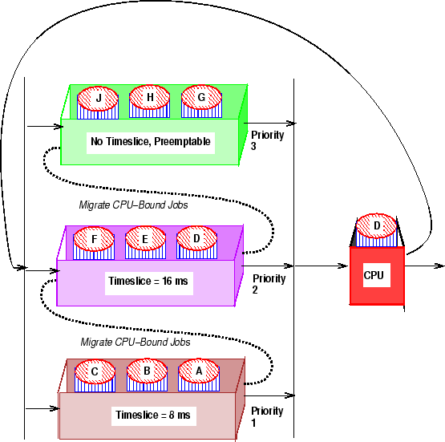
Multi-level Feedback Queue: Example
Notes:
（WT：还是priority 1的优先级最高？因为interactive jobs不用太长时间的timeslice，但是要求最高响应速度？）
规则1：如果A的优先级 > B的优先级，运行A（不运行B）。
规则2：如果A的优先级 = B的优先级，轮转运行A和B。
规则3：工作进入系统时，放在最高优先级（最上层队列）。
规则 4：一旦工作用完了其在某一层中的时间配额（无论中间主动放弃了多少次CPU），就降低其优先级（移入低一级队列）。
规则5：经过一段时间S，就将系统中所有工作重新加入最高优先级队列。

Slide 51
MLFQ: Adjusting Priorities
A job starts in the highest priority queue.
If a job's time slices expires, drop its priority one level.
If a job's time slices does not expire (the context switch comes from an I/O request instead), then increase its priority one level, up to the top priority level.
➔ CPU bound jobs drop like a rock in priority and I/O bound jobs stay at a high priority
Notes:
（WT：还是priority 1的优先级最高？因为interactive jobs不用太长时间的timeslice，但是要求最高响应速度？）
规则1：如果A的优先级 > B的优先级，运行A（不运行B）。
规则2：如果A的优先级 = B的优先级，轮转运行A和B。
规则3：工作进入系统时，放在最高优先级（最上层队列）。
规则 4：一旦工作用完了其在某一层中的时间配额（无论中间主动放弃了多少次CPU），就降低其优先级（移入低一级队列）。
规则5：经过一段时间S，就将系统中所有工作重新加入最高优先级队列。

Slide 52
MLFQ in Unix
The canonical Unix scheduler uses a MLFQ
3-4 classes spanning ~170 priority levels (the higher the better)
Timesharing: first 60 priorities
System: next 40 priorities
Real-time: next 60 priorities
Interrupt: next 10 (Solaris)
Priority scheduling across queues, RR within a queue
The process with the highest priority always runs
Processes with the same priority are scheduled RR
Processes dynamically change priority
Increases over time if process blocks before end of quantum
Decreases over time if process uses entire quantum
Notes:
注意这里说的是经典Unix scheduler，priority level越高，优先级就越高；和Linux中的Priority number不一样

Slide 53
Motivation of the Unix Scheduler
The idea behind the Unix scheduler is to reward interactive processes over CPU hogs
Interactive processes (shell, editor, etc.) typically run using short CPU bursts
They do not finish quantum before waiting for more input
Want to minimize response time
Time from keystroke (putting process on ready queue) to executing keystroke handler (process running)
Don’t want editor to wait until CPU hog finishes quantum
This policy delays execution of CPU-bound jobs
But that’s OKAY!

Slide 54
Summary
Scheduling overview
Scheduling for batch systems
First Come First Serve (FCFS)
Shortest Job First (SJF)
Interactive scheduling
Round Robin (RR)
Priority Scheduling
Priority inversion
Priority inheritance
Multiple-Level Feedback Queues (MLFQ)
Next lecture: Multiprocessor and Real-Time Scheduling

